Slide 1
The Powerpoint file provides:
A conceptual framework for how we have approached the task of developing prospective indicator lists for regions of the outer coast of Washington;
A series of conceptual models of Willapa Bay and Grays Harbor, featuring some of the core physical, ecological, and anthropogenic elements we have initially perceived as central to those ecosystems. Pictorial models help us frame the components and processes; the box-and-arrow model helps us summarize our ideas concisely.
Instructions:
Please note what changes you would make to the model and either discuss those changes at the webinar on July 25, or send those changes to Kelly.Andrews@noaa.gov by August 8.
Thank you.

Slide 2
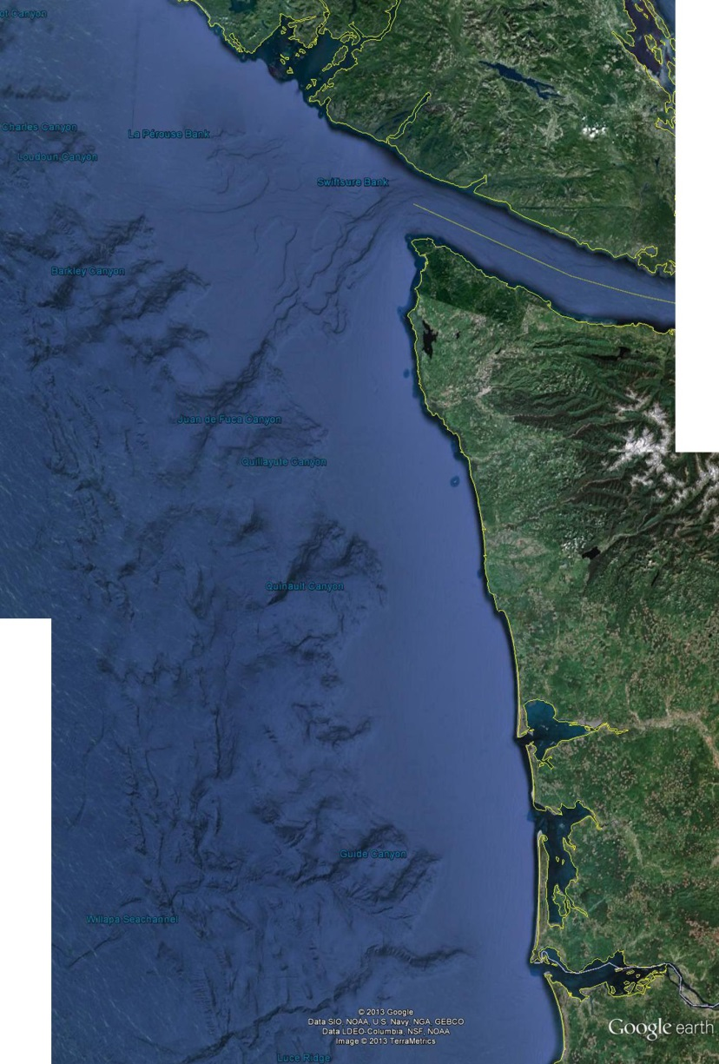
Conceptual framework of ecological indicators for marine spatial planning
Seafloor
Sandy Beaches
Structural Elements
Habitat
quantity, quality
Ecological integrity
Pelagic zone
Ecological components
Fisheries
Rocky shorelines
Focal species
Physical drivers
Human activities
Coastal estuaries
Kelp forest

Slide 3
Coastal estuary habitat
(what are the key components?)

Slide 4
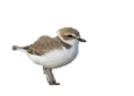
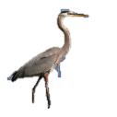
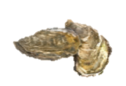
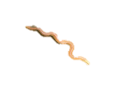
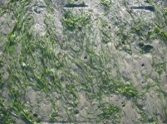
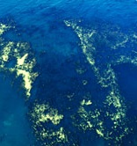
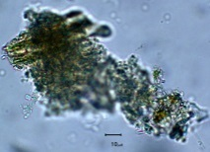
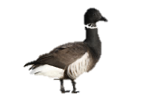
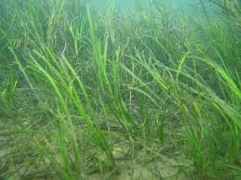
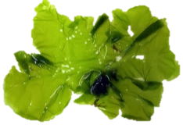
Estuary habitat components
Shorebirds & seabirds
Intertidal zone
Other fishes
Harbor seals
Oysters & clams
Juvenile salmon
Sevengill sharks
Other inverts
Invasive eelgrass
Mouth
(← ocean)
Sturgeon
Phytoplankton
and POM
Mudflats
Tributaries
Burrowing shrimp
Detritus
Native eelgrass
Waterfowl
Dungeness crab
Ulva & other macrophytes

Slide 5
Estuary habitat components
Food web connections
Shorebirds & seabirds
Intertidal zone
Other fishes
Harbor seals
Oysters & clams
Juvenile salmon
Sevengill sharks
Other inverts
Invasive eelgrass
Mouth
(← ocean)
Sturgeon
Phytoplankton
and POM
Mudflats
Tributaries
Burrowing shrimp
Detritus
Native eelgrass
Waterfowl
Dungeness crab
Ulva & other macrophytes

Slide 6
Estuary habitat components
Other weather stuff relevant to intertidal:
Winter storms, desiccation, air temp gradients
Solar energy
Physical drivers
Climate
Change
(including OA)
Shorebirds & seabirds
Intertidal zone
Other fishes
Harbor seals
Oysters & clams
Juvenile salmon
Sevengill sharks
Other inverts
Invasive eelgrass
Mouth
(← ocean)
Tides, Upwelling, Plumes
Sturgeon
Freshwater input
Phytoplankton
and POM
Mudflats
Tributaries
Burrowing shrimp
Sediment resuspension/ bioturbation
Detritus
Native eelgrass
Waterfowl
Dungeness crab
Sediment
input
(Columbia River and local tributaries)

Slide 7
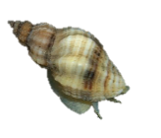
Estuary habitat components
Human activities – Grays Harbor
Port Development
Pollutants
Shorebirds & seabirds
Intertidal zone
Other fishes
Harbor seals
Oysters & clams
Juvenile salmon
Sevengill sharks
Other inverts
Invasive eelgrass
Aquaculture
Mouth
(← ocean)
Fishing
Dredging
Sturgeon
Non-native species
Phytoplankton
and POM
Mudflats
Tributaries
Burrowing shrimp
Detritus
Native eelgrass
Waterfowl
Shipping
Dungeness crab
Watershed activities

Slide 8
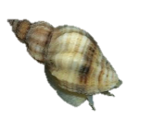
Estuary habitat components
Human activities – Willapa Bay
Pollutants
(including pesticides)
Shoreline Development
Shorebirds & seabirds
Intertidal zone
Other fishes
Harbor seals
Shellfish Aquaculture
Oysters & clams
Juvenile salmon
Sevengill sharks
Other inverts
Invasive eelgrass
Mouth
(← ocean)
Fishing
Sturgeon
Non-native species
Phytoplankton
and POM
Mudflats
Tributaries
Burrowing shrimp
Detritus
Native eelgrass
Waterfowl
Dungeness crab
Watershed activities

Slide 9
Physical drivers
Freshwater input
Sediment dynamics
Tides & upwelling
Plumes
Climate & weather
Ecological
components
Sevengill sharks
Sturgeon
Seals
Habitat
Dungeness crabs
Waterfowl and seabirds
Sand and
mudflats
Fishes
Juvenile salmon
Eelgrass beds
Burrowing shrimp
Oysters & clams
Other inverts
Detritus
Eelgrass & macrophytes
Marine phytoplankton
Human well-being
Fishing
Human activities
Pollution
Dredging _{g}
Shellfish aquaculture_{w}
Non-native species
Watershed activities
Port development _{g}
Commercial shipping _{g}
Figure 12. Conceptual model of important habitat, ecological components, physical drivers and human activities (g: primarily in Grays Harbor; w: primarily in Willapa Bay) for coastal estuary habitat.

Slide 10
What is missing or wrong?
Wait and discuss at webinar
OR
Add comments to each slide or make a list and email to kelly.andrews@noaa.gov

Slide 11
Next?
Develop indicators for each component within the conceptual models
Evaluate indicators using an indicator evaluation process
This evaluation ranks indicators for each component and provides a mechanism for ranking indicators
See PDF of last year’s report if interested in details
Map highly-ranked indicators back onto the conceptual model to ensure all components can be assessed
A potential example is provided on the next slide:
Quantify status and trends of chosen indicators for final assessment

Slide 12
Estuary habitat components
Food web connections
Physical drivers
Pacific Decadal
Oscillation
Human activities
Aquaculture production
% armored shoreline
[Heavy metals]
Other fishes
Shorebirds & seabirds
Simpson diversity (inverts, fishes, birds)
Top predator biomass
Harbor seals
Oyster condition index
Oysters & clams
Aragonite saturation
Juvenile salmon
Sevengill sharks
Other inverts
Smolt-to-adult survival
Invasive eelgrass
Salinity/temp contour maps
Fishery Landings
[chlorophyll a]
Water quality index
Age structure of sturgeon population
Areal extent of non-native species
Sturgeon
Upwelling
Index
Phytoplankton
and POM
Burrowing shrimp density
Burrowing shrimp
Detritus
Ship cargo volume
Native eelgrass
Waterfowl
Sea level change
Scavenger biomass
River discharge
Dungeness crab
Areal extent of habitat
Reservoir storage volume
Ulva & other macrophytes

